Slide 1
AAC: Evaluation to Implementation
Webinar: AAC Profile and Case Studies
February 27, 2013
Mary Baumann-Spooner, M.S. CCC-SLP
& Barbara Commers, M.S. CCC-SLP

Slide 2
Overview
Assessment in the natural environment
Recognize and reinforce multiple modes of communication.
Train communication partners

Slide 3
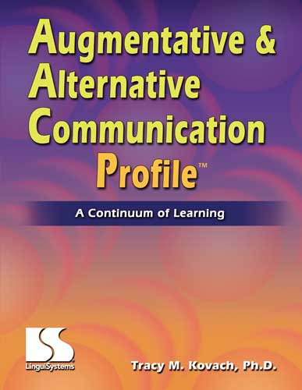
The Augmentative & Alternative Communication Profile: A Continuum of Learning (AAC Profile)
Refer to AAC Profile PDFs to see examples of the protocol of the test

Slide 4
AAC Profile
Measures subjective, functional skills for developing communicative competence using AAC systems.
Assesses current and desired competence
Defines skills needed to increase competence
Defines and coordinates team roles
Administration: 60-90 minutes

Slide 5
AAC Profile
Administration:
Natural environment.
Communication Partner participates in interactions, facilitates communication, and supports the user.
Communication partner skills are assessed.
Notes:
The impact of a partner’s abilities must be considered when determining the communicative competence of the person who uses AAC. Changes in comm. Partner skills alone may impact the comm. Comp. level achieved by the person who uses AAC.
Intervention and instruction with communication partners may increase communicative competence for the person who uses AAC, and should be a component of the intervention program.

Slide 6
AAC Profile
Guides multidisciplinary service providers and family members:
Coordinate individual roles
Develop and implement instructional strategies for communication
Identify contexts and environments to support communication

Slide 7
AAC Profile
No special materials needed.
Create a communication environment using activities that are motivating and age- and ability- appropriate.
Communication partners provide needed “wait time” for individual’s to initiate, respond, take a turn.
Observe interaction and record.

Slide 8
AAC Profile
Areas of Learning
Operational
Linguistic
Social
Strategic
Table 1
.

Slide 9
AAC Profile
Skill Sets: Five ability based levels under each of the Areas
Simple early functioning to independent use and AAC system mastery
Communicative Competence Levels:
Summary of how the person is generally functioning
Table: Communicative Competence Levels for Areas of Learning
Performance Profile Summary
Graph: Skill Set Levels for Skill Areas

Slide 10
AAC Profile
Scoring
3= Frequently Used Skill
2=Sometimes Used Skill
1=Seldom Used Skill
Application of the Performance Profile Summary
Skill Level are determined from 5 different levels and transferred to the 1st Page
Developing Objectives
Team can look at skill levels and determine objectives to work on with the student

