Slide 1
AAC Resources Evaluation to Implementation
Presented by: Ann McCormick, Barbara Commers and Mary Baumann-Spooner

Slide 2
Todays Goals
Legal Considerations
AAC Evaluations
AAC Implementation Strategies
AAC Devices and Features
Online Resources

Slide 3
Definition of Assistive Technology
Tech Act of 1988 - first formal, legal definition of assistive technology; amended in 1994;
1998 - repealed and replaced with the Assistive Technology Act of 1998
(AT Act). The original definition of assistive technology has remained consistent.

Slide 4
Assistive Technology Device
Section 300.5 Assistive technology device.
Any item, piece of equipment or product system, whether acquired commercially off the shelf, modified, or customized, that is used to increase, maintain, or improve the functional capabilities of a child with a disability.The term does not include a medical device that is surgically implanted, or the replacement of such device. (Authority 20 U.S.C. 1401(1))

Slide 5
Assistive Technology Service
Section 300.6 Assistive technology service
is any service that directly assists a child
with a disability with the selection,
acquisition, or use of an assistive
technology device. The term includes-
(a) The evaluation of the needs of a child with a disability, including a functional evaluation of the child in the child’s customary environment;

Slide 6
Assistive Technology Service
Section 300.8 Continued
(b) Purchasing, leasing, or otherwise providing for the acquisition of assistive technology devices by children with disabilities;
(c) Selecting designing, fitting, customizing, adapting, applying, retaining, repairing, or replacing assistive technology devices;

Slide 7
Assistive Technology Service
Section 300.8 Continued
(d) Coordinating and using other therapies, interventions, or services with assistive technology devices, such as those associated with existing education and rehabilitation plans and programs;
(e) Training or technical assistance for a child with adisability or, if appropriate, that child’s family; and

Slide 8
Assistive Technology Service
Section 300.8 Continued
(f) Training or technical assistance for professionals (including individuals or rehabilitation services), employers, or other individuals who provide services to employ, or are otherwise substantially involved in the major life functions of children with disabilities.
See Support Components handout

Slide 9
Individuals with Disabilities Act, 1990, 1997, 2004.
IDEA in 1990 first outlined the school districts responsibility to provide AT to students with disabilities.
IDEA used the definition from the Tech Act for AT device and service; reauthorized in 1997, and 2004.

Slide 10
IDEA 2004 Sec. 300.105 Assistive Technology
(a) Each public agency must ensure that assistive technology devices or assistive technology services, or both, as those terms are defined in Sec. 300.5 and 300.6, respectively, are made available to a child with a disability if required as a part of the child's--
(1) Special education under Sec. 300.36;
(2) Related services under Sec. 300.34; or
(3) Supplementary aids and services under Sec.

Slide 11
IDEA 2004 Sc. 300.38 and 300.114 (a) (2) (ii).
(b) On a case-by-case basis, the use of school-purchased assistive technology devices in a child's home or in other settings is required if the child's IEP Team determines that the child needs access to those devices in order to receive FAPE.
(Authority: 20 U.S.C. 1412(a)(1), 1412(a)(12)(B)(i) )

Slide 12
American Speech Language and Hearing Association (ASHA):
"An area of clinical practice that attempts to compensate (either temporarily or permanently) for the impairment and disability patterns of individuals with severe expressive communication disorders."

Slide 13
AAC Definition
AAC refers to all communication that supplements or augments speech.
AAC covers a broad range of techniques, strategies and devices.
Devices range from simple picture boards to sophisticated, computer based devices with synthetic voice.
Other AAC may include facial expressions, gestures, body postures, sign language, drawing, and writing.

Slide 14
AAC Evaluation
AAC evaluation is primarily about
communication
NOT
technology

Slide 15
MODELS OF AAC EVALUATION
Candidacy Model –(1970s – 1980s)
An eligibility model
“too something” to qualify for AAC services.
“too many” of some skills.
“not ready for” criteria (prerequisite skills).
Insufficient discrepancy between cognitive and language/communication
functioning on formal tests.
NONE OF THESE ELIGIBILITY CRITERIA IS SUPPORTED BY RESEARCH, AND NONE IS APPROPIATE TO APPLY FOR ACCESS TO AAC SERVICES.

Slide 16
MODELS OF AAC EVALUATION
Communication Needs Model (1980s – 1990s)
Candidacy for AAC interventions based on an individual’s unmet communication needs.
Process:
Document the communication needs.
Determine how many of these needs are met through current system.
Design AAC intervention to meet needs that are not being met.

Slide 17
MODELS OF AAC EVALUATION
Participation Model – (2000s)
Process for conducting AAC assessment and designing intervention based on the functional participation requirements of peers without disabilities of the same age as the person who uses AAC.

Slide 18
PHASES OF EVALUATION
Phase I: Initial Assessment for Today –
Supports immediate communication interaction so that communication can begin.
Assess current communication needs.
Assess physical, cognitive, language, and sensory capabilities.
Match today’s needs and capabilities.

Slide 19
PHASES OF EVALUATION
Phase II: Detailed Assessment for Tomorrow –
Develop a communication system that will support the individual in a variety of environments beyond the familiar ones.
Requires careful assessment of the individual’s expected participation patterns.
Match the participation requirements of each setting.

Slide 20
PHASES OF EVALUATION
Phase III: Follow-up Assessment –
Maintaining AAC system that meets the changing capabilities and lifestyles
Periodically examine communication equipment
Assess needs and abilities of communication partners
Reassess the capabilities of the AAC user
Vital and frequent phase for degenerative illness

Slide 21
GOAL OF AAC EVALUATION
To facilitate the most effective communication possible across a variety of communication environments.
By making informed decisions about:
The adequacy of the current communication system
The individual’s current and future communication needs.
The AAC techniques that appear to be most appropriate.
How to provide instruction regarding the use of these techniques.
How to evaluate the outcomes.

Slide 22
AAC EVALUATION
Primary purpose is to gather enough information in order to determine certain capabilities and functions for an AAC system or device.
Extensive information is not necessary in gathering preliminary information about cognitive and language skills.
Zero Rejection Policy!

Slide 23
AAC EVALUATION BASICS
Focus is not on diagnosing a disorder. It is usually very clear that the student has some type of disorder.
Focus is on considering how the student might use AAC to enhance his/her daily life communication.
When conducting an AAC assessment, we systematically search for the student’s strengths, with a very practical focus on how those strengths can be used to help the person communicate.

Slide 24
SPEECH/LAGUAGE AND AAC EVALUATIONS
Traditional speech/language evaluation focus is on describing the nature and extent of the communication disability, estimating prognosis, designing an initial framework for intervention.
AAC assessment assumes that the communication is chronic and that natural language is not likely to occur. Therefore, the focus on the assessment shifts to designing an AAC system that will provide for the highest level of generative communication that can be achieved.

Slide 25
THREE TYPES OF REQUIRED INFORMATION
Evidenced Based Practice
Knowledge about best practices
Knowledge about the student – Identification of the
individual’s abilities, needs and expectations.
Assessment process
Knowledge about devices, technology and systems
Gathering information about technology and remaining current

Slide 26
FEATURE MATCH
Then,
Match the individual’s abilities, needs and expectations to AAC device features and strategies. Assess AAC Features and Strategies Through Trial Periods and Mock-ups
Revise and refine feature match decisions
Address environmental issues
Reach team consensus
Develop on-going implementation plan reflecting the individual’s abilities, needs and expectations.

Slide 27
Begin with what you know:
Communication Environments - “A student’s environment is the single most important factor in developing communication skills”;
In which places does the student have to communicate?
When does the student have to communicate?
What might the student say in each setting?
What type of AAC system would work best?
Communication Partners
Communication Skills
Communication Needs
Physical Skills
Sensory Limitations

Slide 28
GUIDELINES
AAC evaluation must:
Be transdisciplinary: evaluate and observe with other team members so testing is not duplicated.
Focus on what the client can do, not what s/he can’t do.
Attempt to determine stimulability or potential for learning or using various AAC systems.
Use pre-evaluation questionnaires & results from previous test to gain information.

Slide 29
SPECIFIC ASSESSMENT
Overall – evaluate:
The individual’s ability to use existing expressive communication modes.
The individual’s current communication needs.
The individual’s communication environments and routines within those environments.
Communication partner characteristics.

Slide 30
SPECIFIC ASSESSMENT
Physical Level
Medical
Fatigue
Natural Speech
Motor Capabilities – goal is to identify optimal seating and positioning and motor techniques for access.
Determine a motor response for accessing an AAC system

Slide 31
SPECIFIC ASSESSMENT
Sensory/Perceptual – goal is to determine vision and hearing, as well as size, type, placement of symbols and language input and output options.
- Visual
- Auditory
- Symbols

Slide 32
SPECIFIC ASSESSMENT
Educational Perspective:
Cognitive
Language – Comprehension and Expression (semantics, syntax, morphology, pragmatics)
Symbolic Comprehension and Expression
Literacy Levels

Slide 33
SPECIFIC ASSESSMENT
Personal Qualities:
Social ability
Behavior
Motivation
Technology
Team Supports
Non-technical back-up system
Use assessment information to develop a list of AAC devices to consider for further evaluation.

Slide 34
SPECIFIC ASSESSMENT
Lack of formalized and standardized AAC assessment tools:
Must adapt and modify existing instruments
Must search for and find additional protocols, tools and techniques
Must have expertise to interpret informal/nonstandardized assessment
Absence of formal tests often results in unorganized and incomplete recording of what was tested, how it was tested and exact results.
Programming is an essential form of ongoing assessment.
Regardless of the type of assessment used, thorough documentation is necessary to communicate results across people and time.

Slide 35
Sample Protocols
Communication Matrix
Functional Communication Profile
Social Networks
Every Move Counts
TASP – Test of Aided Communication symbol Performance
Symbol Assessment – bcommers adapted from Miranda
Communication Samples-Forms/Functions
INCH – Interactive Checklist for Augmentative Communication.

Slide 36
INFORMAL AAC FRAMEWORKS
WATI (Wisconsin Assistive Technology Initiative)
Assessing Student’s Needs for Assistive Technology.
Designed to analyze fine motor skills related to computer or device use, communication, seating and positioning, mobility, vision and hearing.
SETT Framework (Joy Zabala)
Assess Student, Environment, Task and Tools

Slide 37
INFORMAL AAC FRAMEWORKS
MPS AAC SETT
GPAT (Georgia Project for Assistive Technology)
Seminole County Public Schools
Children’s Treatment Network of
Simcoe York

Slide 38
Software Programs
EvaluWare – ATI software to assess access.
Stages – (Madeline Pulgliese) Software
Exploratory Page Sets developed by manufactures.

Slide 39
SPECIFIC ASSESSMENT
Evaluation is more than a battery of tests and written reports.
Assessment is not a one shot deal, it is an ongoing process.
AAC evaluation involves more than assessing the individual. It looks at the potential AAC user, the environment and the communication partner.
May be formal or informal.
Don’t test what is not needed
Make a video to share with team members

Slide 40
FEATURE MATCH
One of the most popular methods used to determine the best AAC system.
You must match the needs of the individual to the features that are possible in a variety of devices.
Why learn about features?
Literally hundreds of AAC devices on the market – it is impossible to have experience with each one.
New devices become available every year.
Families may hear about a device before you do.

Slide 41
FEATURE MATCH
Therefore,
You should not aspire to learn about all the individual devices on the market – you would never succeed!
It is better if you learn about the features of AAC systems, so that you can evaluate new devices as they emerge.
The vast majority of devices share features with existing systems.
Learn about new devices by comparing its
features to those of the existing system.

Slide 42
FEATURE MATCH
Lite-Mid Tech
Typically used to facilitate the development of emerging language and communication skills:
Participation
Choice making
Even lite-mid tech systems can sometimes be overwhelming, time-consuming and cumbersome.
May be very limiting.
Does not exclude the use of a high tech device.

Slide 43
FEATURE MATCH
High Tech
Dedicated: manufactured specifically for communication.
Integrated: built upon standard computer platform. Special communication software is typically added to enhance the computer’s ability to function as a communication device.

Slide 44
LITE TECH VS. HIGH TECH
AAC is most effective when thought of as a “system” rather than a specific device or piece of equipment.
The greater the variety of communication options that a student has to choose from, the better opportunity s/he will have to communicate in every situation.
i.e. bathroom or swimming may not lend itself to the use of a high tech system.
Using this “system” approach avoids the pitfalls of relying on only one device or technique.
High tech devices may break down and need repairs, with lite tech devices serving in the interim.

Slide 45
FEATURE MATCH
AACTechConnect available at
www.aactechconnect.com free trial
Special Education Technology (SET) – BC – AAC Device Feature Comparison
www.setbc.org
Guide to Picture and symbol sets
www.callcentrescotland.org.uk
Communicator Feature Comparison from Enabling Devices. http://enablingdevices.com/files/content/ComparisonChart.pdf
Feature Match - BCommers adapted from U. Washington –
copy in your packet

Slide 46
Trial Period
Final purchase should be made only after:
The communication partners have made an honest effort to use the AAC system with the student;
The student has shown an ability and interest in using it during the trial period.

Slide 47
Ten Principles of AAC Assessment LLloyd
1. EVERYONE CAN AND DOES COMMUNICATE (DOCUMENT CURRENT METHODS)
AAC ASSESSMENTS MUST:
2. BE CONSUMER DRIVEN (NEEDS OF CLIENT &FAMILIES)
3. BE CONDUCTED BY COLLABORATIVE TEAMS.
4. FOCUS ON FUNCTIONAL, DAILY LIFE ACTIVITIES.(ADMINISTERING TESTS WILL NOT SUFFICE – HELPING A PERSON WHO USES AAC TO MAXIMIZE PARTICIPATION IN EVERYDAY LIFE IS A MAJOR FOCUS OF INTERVENTION; MUST GATHER INFO DURING ASSESSMENT THAT WILL AFFECT DAILY LIFE).
5. FOCUS ON FUNCTIONAL IMPLICATIONS OF THE DISORDER, NOT THE DISORDER ITSELF.
(DO NOT NEED TO EXTENSIVELY DIAGNOSE AND DESCRIBE THE DISRODER; MUST FOCUS ON THE IMPACT THE DISABILITY HAS ON DAILY LIFE; WHAT DOES CLIENT NEED TO DO TO PARTICIPATE IN DAILY LIFE).

Slide 48
Ten Principles of AAC Assessment LLloyd
6. FOCUS ON STRENGTHS AND ABILITIES.(MUST FIND OUT WHAT SUTDENT CAN DO IN ORDER TO IDENTIFY APPROPRIATE AAC SOLUTIONS THAT WILL BE FUNCTIONAL)
7. FOCUS ON FEATURE MATCHING.
8. ADHERE TO THE LAW OF PARSIMONY! (KEEP THIS INHERENTLY COMPLEX PROCESS AS SIMPLE AS POSSIBLE; PROVIDE SIMPLE AAC SOLUTIONS THAT MEET COMMUNICATION NEEDS).
9. BE AN ONGOING PROCESS.(TRANSISTION, DEGEN.)
10.RESULT IN POSITIVE CHANGE. (IF WE HAVE NOT MADE LIFE BETTER WE HAVE NOT DONE OUR JOB: COLLECT DATA, DOCUMENT CHANGE, REVISE PLAN).

Slide 49
Four Components of Communicative Competence by Janice Light
LINGUISTIC COMPETENCE Receptive and expressive language skills of one’s native language.
OPERATIONAL COMPETENCE Technical skills needed to operate the AAC system accurately and efficiently.
SOCIAL COMPETENCE Skills of social interaction such as initiating, maintaining, developing, and terminating communication.
STRATEGIC COMPETENCE Compensatory strategies that people who rely on AAC use to deal with functional limitations associated with AAC use. i.e. resolving communication breakdown.
See Functional Communication Training

Slide 50
AAC Protocols
-Communication Samples
-Functional Communication Profile-Revised
- AAC Guided Assessment-Daily Comm. Partners
-Social Networks: A Communication Inventory for Ind. with Complex Comm. needs and their Comm. Partners

Slide 51
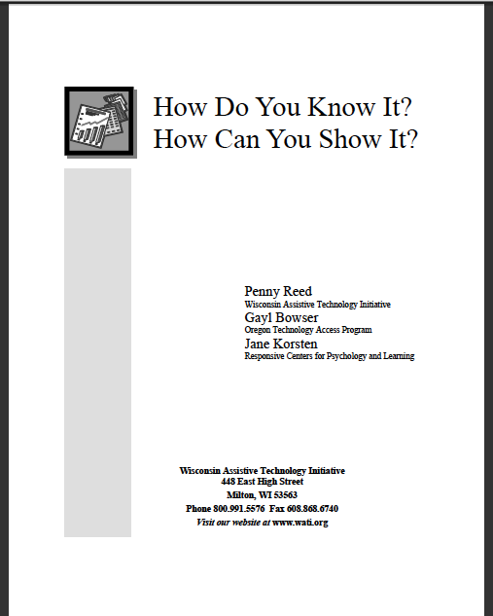
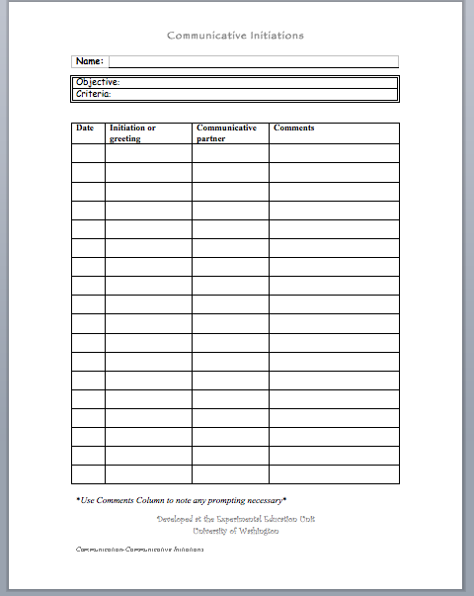
Communication Samples
Ecological Inventory
Paul Olson, MS CCC-SLP, ISD 728 Elk River School Dist.
Enhancing Everyday Comm. for Children with Disabilities, Sigfoos et al.
How do You Know it Show Me the Data
Penny Read, Gayle Bowser, Jane Korsten Experiment Ed. Unit from the University of WA
Notes:
CLICK ON THE UNDERLINED TEXT OR PICTURES TO SEE ONLINE RESOURCES

Slide 52
Communication Samples
Population-used for all populations to determine current level of communication skills and areas to be worked on
3 Resources:
-Ecological Inventory for Core, Fringe, Social Language. Observe student and peers to develop AAC vocab needed
-How Do You Know It-Know It- How Do You Show It and Show Me The Data Forms are good for data collection and progress monitoring
Notes:
Ecological inventories are a systematic way to review the vocabulary a student with an AAC device will need to access in their environment. Core, Fringe and Social vocabulary are documented. (scroll to the bottom of the page to see a scanned copy of the inventories)
How do you Know it How do you Show is a book on data collecting for all AT devices. AAC is reviewed and there are data sheets in the apendix pgs 117-127. I really like the rating form for devices.
Show Me the Data is full of already created forms that come on a CD. They are linked on the Montgomery County Public Schools site also. Datasheets include asking/answering questions, communication initiations and many more.

Slide 53
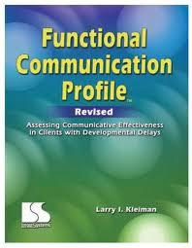
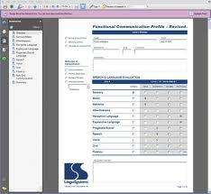
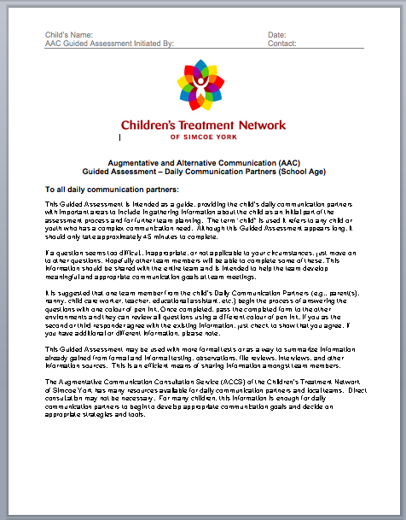
AAC Evaluations

Slide 54
AAC Guided Assessment by Children's Treatment Network, Simcoe York, Canada
Population- Standard to Complex AAC needs assessed for all populations.
Overview of Assessment:
-Combines several recognized AAC methods
-Includes partner information and strategies
-Indepth and includes access methods for multiply impaired
-"Next steps" gives teams action plan for programming
Notes:
This is a guided assessment that provides the child's communication partners with important areas to include in gathering information about the child as an initial part of the assessment process for team planning of AAC systems. It should take about 45 minutes to complete. Daily Communication Partners (i.e. parents, teachers, child care providers) fill out the form in different colored ink, passing it among each other. This way all responses on are on the same form. It combines parts from the Social Networks test and SETT Framework. Has various communicative functions so goals have been easily derived from information reported by the team. Address access needs of student so it is appropriate to use with multiply impaired students. Partner strategies can also be identified and put in the adaptation section of the IEP. Task section identifies communication needs during the students day. There is a section for identifying goals, need training for communication partners and further consultation needed.

Slide 55
Functional Communication Profile by Larry I. Kleiman
Population-students with autism and pervasive developmental disorders
Overview of Assessment:
-Comprehensive assessment including non-verbal, AAC systems, speech, voice, oral and fluency skills
-Checklist rating form is easy and quick to fill out
-Uses multiple methods to obtain ratings
Notes:
This assessment is a comprehensive guide that rates students major skill levels in the areas of communication (sign, non-verbal, augmentative). It is designed to review the full spectrum of communication disorders especially students with autism or pervasive developmental disorders. The manual contains detailed descriptions and definitions of each targeted skills and gives suggestions on how to gather the information needed. There is no scoring system, but an overall inventory of skills is developed to provide a picture of the student's communication abilities.

Slide 56
Social Networks: A Comm. Inventory by Sarah W. Blackstone, Ph.D. and Mary Hunt Berg, Ph.D.
Population-students with complex communication needs and their partners
Overview of Assessment:
-Takes a "person centered" approach
-Communication methods are id across environments
-Includes reading and writing abilities
-Easy to use checklists and summary sheets
Notes:
This evaluation takes a "person centered" approach to develop AAC strategies and actively involves the individual along with their support system. Using a structured inventory, a profile of communication partners is identified and communication methods are delineated across contexts. Distinctions are made based on a person's observable communication behaviors, rather than language or communication abilities. It focuses on the the student's social networks by identifying times and ways to use AAC to socialize with others. Less "drill and kill" approach and more centered on the student's environment.

Slide 57
AAC WEB RESOURCES
Assistive Technology Training On-line (ATTO) - provides information on AT applications that help students with disabilities learn in elementary classrooms.
http://atto.buffalo.edu/
Florida Assistive Technology Education Network (ATEN) Homepage has tutorials that can be downloaded on a variety of assistive technology devices. http://www.aten.scps.k12.fl.us/.
Georgia Project for Assistive Technology (GPAT) The mission of GPAT is to improve student achievement, productivity, independence and inclusion by enhancing educator knowledge of assistive technology and increasing student access to appropriate assistive technology devices and services. www.gpat.org
University of Washington, Seattle - Educational site developed at the University of Washington, with a particular emphasis on Vocabulary and Symbols, Understanding AAC Device Features and Funding. Also includes Glossary of Terms and Video Profiles of AAC and Assistive Technology Users.
http://depts.washington.edu/augcomm/index.htm

Slide 58
AAC Formats
- Communication Matrix
- Every Move Counts
- AAC SETT
- Test of Aided-Communication Symbol Performance (TASP)

Slide 59
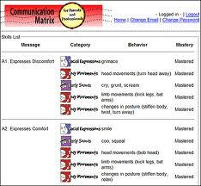
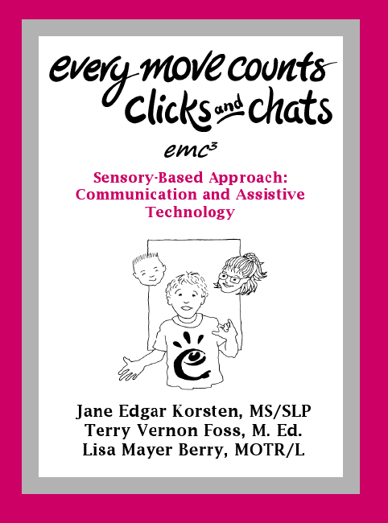
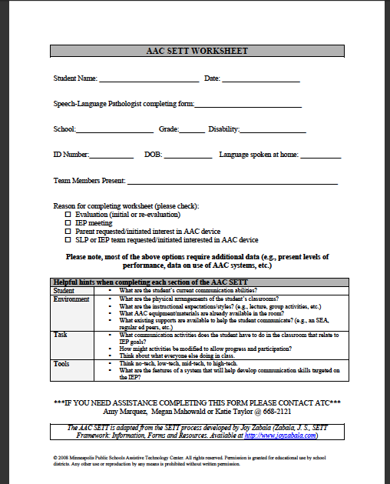
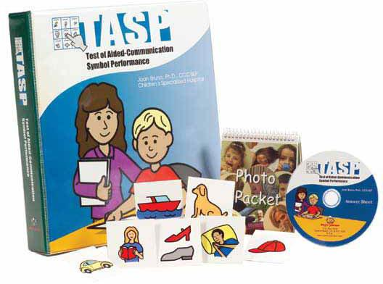
AAC Formats

Slide 60
Communication Matrix Charity Rowland, Ph.D. (www.communicationmatrix.org)
Population-Learners at all ages whose communication skills are at the birth to 24 months range
Overview of Assessment:
- Staff version & parent (online) version
- Respond to questions re: learner's communication skills
- Assesses communicative behaviors, communicative functions and level of communication (7 levels)
- 10 minutes to an hour to complete
- Provides visuals re: how learner is communicating and targets for intervention

Slide 61
Every Move Counts, Clicks & Chats Jane Edgar Korsten, Terry Vernon Foss & Lisa Meyer Berry
Population- Learners "perceived as having 'severe and profound sensorimotor differences'."
Overview of Assessment:
- First "Counts": build association between symbol & event
- "Counts" includes a Sensory Assessment (with learner), Communication Assessment (observation/interview) and Symbol Assessment
- Then "Clicks" (purposeful switch use) then CHATS (add voice output) assessments
- Detailed flowcharts/text guide intervention implementation
-
-

Slide 62
AAC SETT (Student, Environment, Tasks, Tools)
Population-Any learner who needs AAC, with focus on those who don't have a formal language system
Overview of Assessment:
- Framework includes observation and team judgment
- Student profile based on intentionality
- Tools: Feature Match
-Symbols/vocab, access, visual display, output, etc.
-Embeds Ecological Inventory piece
-

Slide 63
Test of Aided-Communication Symbol Performance (TASP)
Population-Learners who can attend to a task, recognize line drawings & direct-select from a 4-pic array
Overview of Assessment
- Individually administered
- Systematic/objective
-field/symbol size
-grammatical encoding
-categorization skills
-syntax
-Use results for goal-setting, displays, selecting devices

Slide 64
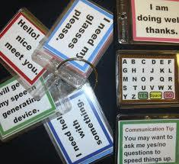
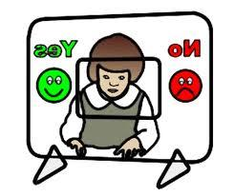
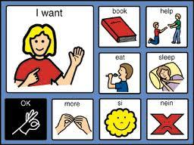
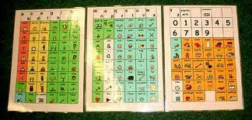
Manual AAC Systems Static Boards
-Eye Gaze
-Basic Needs Board
-AAC Ring Systems

Slide 65
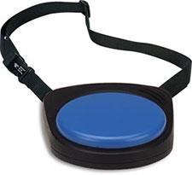
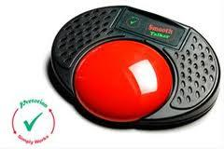
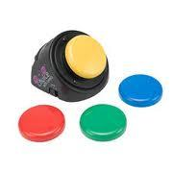
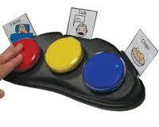
Light AAC Systems Simple Voice Output Devices
-Big Mac
-Smooth Talker
-Step by Step
-Talkables

Slide 66
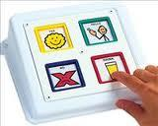
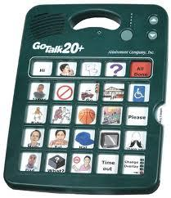
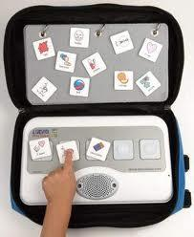
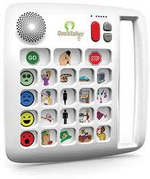
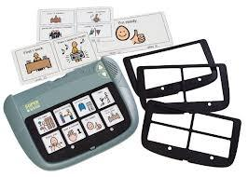
Mid AAC Systems VOD with Multiple Levels
-Cheap Talk
-Go Talk
-Super Talker
-Quick Talker
-Prox Talker

Slide 67
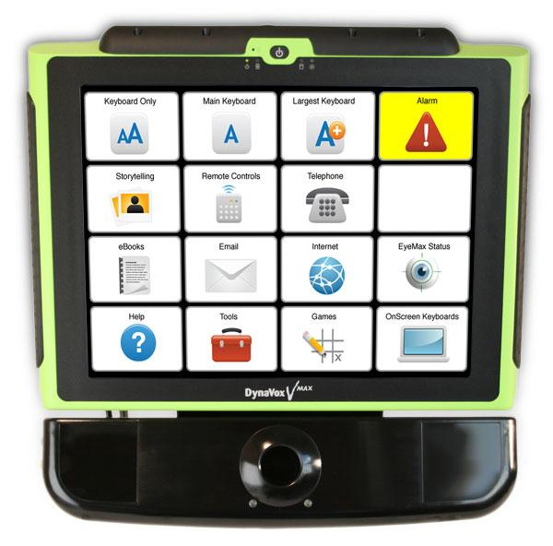
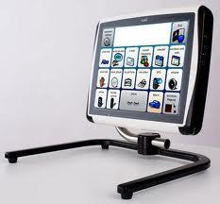
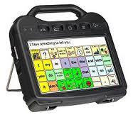
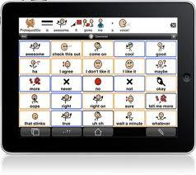
High Tech Devices Dynamic Display
-Dynavox
-Tobii
-Prentke Romich
-iPad/Tablet and Apps
Notes:
Dynavox/Tobii systems are dynamic display systems. These systems refer to a device or software that displays vocabulary as test or graphics on a screen and is able to be changed electronically. The organizational system is similar to computers where page sets are categorized and kept in files that link to AAC boards related to that category.
Prentke Romich devices uses an organizational system known as Semantic Compaction, also known as Minspeak, is based on iconic encoding. Each symbol may be associated with multiple meanings. For example apple can stand for “apple, eat, hungry”.
iPad apps can range from simple 1 message device to dynamic display. Tap Speak, Go Talk Now, Proloquo2Go, Prentke Romich, Tobii

Slide 68
Curriculum Strategies
Developing and Using a Communication Book by ACE Centre (Clare Latham)
-Pragmatic Organization Dynamic Display
by Gayle Porter
-Picture Exchange Communication System
by Pyramid Education (Lori Frost & Andy Bondy, Ph.D.)
-Two Switches to Success and Can We Chat?
by Linda Burkhart

Slide 69
Developing & Using a Communication Book
Population: Learners who are producing some communicative behaviors
Simple guide
-Core/fringe vocabulary
-Emphasis on communication partner to use/model the symbols (Aided Lang
Stim) in addition to supporting learner
-Five stages

Slide 70
Pragmatic Organization Dynamic Displays (PODD)
Population: Beginning communicators
Manner of organizing the vocabulary/ symbols in a communication book
-PCS/Boardmaker
-Based on communication function &
conversational discourse
-Supports receptive understanding &
provides aided lang stim; child output

Slide 71
Picture Exchange Communication System (PECS)
Population: Originally preschoolers with social-communication challenges, now broader use; need fine motor/visual discrim skills
Training Protocol
-Based on ABA principles
-Critical Communication Skills Checklist
-Approach communication partner &
exchange pic for desired item

Slide 72
Two Switches to Success
Population: "Access for Children with Severe Physical and/or Multiple Challenges"
Progression of eight steps
-Types of scanning
-Fromsingle switch to two-switch step
scanning

Slide 73
Can We Chat?
Population: "Students who are not yet highly successful communicators"
"A Make It/Take It Book"
-Parallel Programming (Goosens)
-Sequenced social script development
-"Feel" of successful conversations
-Co-planned; programmed into step-
listening device

